Slide 1
DS&AI Project: Knowledge Engineering - Reasoning about Knowledge
Marcello Bonsangue
LIACS – Leiden University
m.m.bonsangue@liacs.leidenuniv.nl
Reusing slides from Iyad Rahwan

Slide 2
Overview
The partition model of knowledge
Introduction to modal logic
The S5 axioms
Common knowledge
Applications to robotics
Knowledge and belief

Slide 3
The Muddy Children Puzzle
n children meet their father after playing in the mud. The father notices that k of the children have mud on their foreheads.
Each child sees everybody else’s foreheads, but not his own.
The father says: “At least one of you has mud on his forehead.”
The father then says: “Do any of you know that you have mud on your forehead? If you do, raise your hand now.”
No one raises his hand.
The father repeats the question, and again no one moves.
After exactly k repetitions, all children with muddy foreheads raise their hands simultaneously.

Slide 4

Muddy Children (cont.)
Suppose k = 1
The muddy child knows the others are clean
When the father says at least one is muddy, he concludes that it’s him

Slide 5
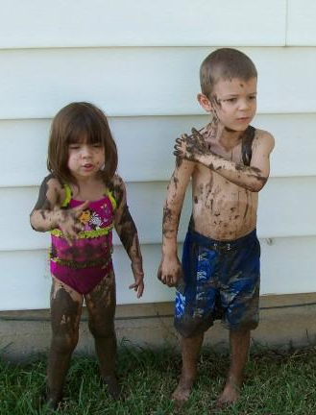
Muddy Children (cont.)
Suppose k = 2
Suppose you are muddy
After the first announcement, you see another muddy child, so you think perhaps he’s the only muddy one.
But you note that this child did not raise his hand, and you realise you are also muddy.
So you raise your hand in the next round, and so does the other muddy child

Slide 6
The Partition Model of Knowledge
An n-agent a partition model over language Σ is A=(W, π, I₁, …, I_{n}) where
W is a set of possible worlds
π : Σ → 2^{W} is an interpretation function that determines which sentences are true in which worlds
Each I_{i} is a partition of W for agent i
Remember: a partition chops a set into disjoint sets
I_{i}(w) includes all the worlds in the partition of world w

Slide 7
Partition Model (cont.)
What?
Each I_{i} is a partition of W for agent i
Remember: a partition chops a set into disjoint sets
I_{i}(w) includes all the worlds in the partition of world w
Intuition:
if the actual world is w, then I_{i}(w) is the set of worlds that agent i cannot distinguish from w
i.e. all worlds in I_{i}(w) all possible as far as i knows

Slide 8
Partition Model (cont.)
Suppose there are two propositions p and q
There are 4 possible worlds:
w₁: p ∧ q
w₂: p ∧ ¬ q
w₃: ¬ p ∧ q
w₄: ¬ p ∧ ¬ q
Suppose the real world is w₁, and that in w₁ agent i cannot distinguish between w₁ and w₂
We say that I_{i}(w₁)={w₁, w₂}

Slide 9
The Knowledge Operator
Let K_{i}ϕ mean that “agent i knows that ϕ”
Let A=(W, π, I₁, …, I_{n}) be a partition model over language Σ and let w ∈ W
We define logical entailment |= as follows:
For ϕ ∈ Σ we say (A,w |= ϕ) if and only if w ∈ π(ϕ)
We say A,w |= K_{i}ϕ if and only if ∀w’,
if w’∈I_{i}(w), then A,w |= ϕ

Slide 10
The Knowledge Operator (cont.)
What?
We say A,w |= K_{i}ϕ if and only if ∀w’,
if w’∈I_{i}(w), then A,w |= ϕ
Intuition: in partition model A, if the actual world is w, agent i knows ϕ if and only if ϕ is true in all worlds he cannot distinguish from w

Slide 11
Muddy Children Revisited
n children meet their father after playing in the mud. The father notices that k of the children have mud on their foreheads.
Each child sees everybody else’s foreheads, but not his own.

Slide 12
Muddy Children Revisited (cont.)
Suppose n = k = 2 (two children, both muddy)
Possible worlds:
w₁: muddy1 ∧ muddy2 (actual world)
w₂: muddy1 ∧ ¬ muddy2
w₃: ¬ muddy1 ∧ muddy2
w₄: ¬ muddy1 ∧ ¬ muddy2
At the start, no one sees or hears anything, so all worlds are possible for each child
After seeing each other, each child can tell apart worlds in which the other child’s state is different

Slide 13
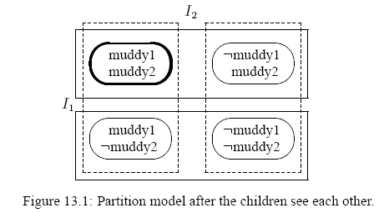
Muddy Children Revisited (cont.)
Bold oval = actual world
Solid boxes = equivalence classes in I₁
Dotted boxes = equivalence classes in I₂

Slide 14
Muddy Children Revisited (cont.)
The father says: “At least one of you has mud on his forehead.”
This eliminates the world:
w₄: ¬ muddy1 ∧ ¬ muddy2

Slide 15
Muddy Children Revisited (cont.)
Bold oval = actual world
Solid boxes = equivalence classes in I₁
Dotted boxes = equivalence classes in I₂

Slide 16
Muddy Children Revisited (cont.)
The father then says: “Do any of you know that you have mud on your forehead? If you do, raise your hand now.”
Here, no one raises his hand.
But by observing that the other did not raise his hand (i.e. does not know whether he’s muddy), each child concludes the true world state.
So, at the second announcement, they both raise their hands.

Slide 17
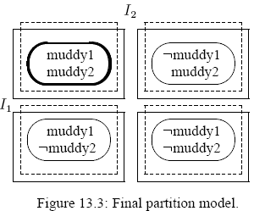
Muddy Children Revisited (cont.)
Bold oval = actual world
Solid boxes = equivalence classes in I₁
Dotted boxes = equivalence classes in I₂
Note: in w₁ we have:
K₁ muddy1
K₂ muddy2
K₁ K₂ muddy2
…

Slide 18
Modal Logic
Can be built on top of any language
Two modal operators:
ϕ reads “ϕ is necessarily true”
◊ϕ reads “ϕ is possibly true”
Equivalence:
◊ϕ ≡ ¬¬ϕ ϕ ≡ ¬◊¬ϕ
So we can use only one of the two operators

Slide 19
Modal Logic: Syntax
Let P be a set of propositional symbols
We define modal language L as follows:
If p ∈ P and ϕ, ψ ∈ L then:
p ∈ L ¬ϕ ∈ L ϕ ∧ ψ ∈ L ϕ ∈ L
Remember that
◊ϕ ≡ ¬¬ϕ and ϕ ∨ψ ≡ ¬ (¬ϕ ∧¬ψ) and ϕ →ψ ≡ ¬ϕ ∨ ψ

Slide 20
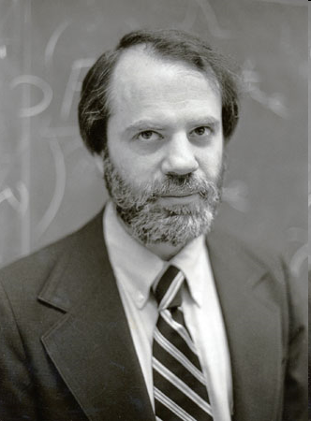
Modal Logic: Semantics
Semantics is given in terms of Kripke Structures (also known as possible worlds structures)
Due to American logician Saul Kripke, City University of NY
A Kripke Structure is (W, R)
W is a set of possible worlds
R : W × W is a binary accessibility relation over W

Slide 21
Modal Logic: Semantics (cont.)
A Kripke model is a pair M,w where
M = (W, R) is a Kripke structure and w ∈ W is a world
The entailment relation is defined as follows:
M,w |= ϕ if ϕ is true in w
M,w |= ϕ ∧ ψ if M,w |= ϕ and M,w |= ψ
M,w |= ¬ϕ if and only if we do not have M,w |= ϕ
M,w |= ϕ if and only if ∀w’ ∈ W such that R(w,w’) we have M,w’ |= ϕ

Slide 22
Modal Logic: Semantics (cont.)
As in classical logic:
Any formula ϕ is valid (written |= ϕ) if and only if ϕ is true in all Kripke models
E.g. ϕ ∨ ¬ϕ is valid
Any formula ϕ is satisfiable if and only if ϕ is true in some Kripke models
We write M, |= ϕ if ϕ is true in all worlds of M

Slide 23
Modal Logic: Axiomatics
Is there a set of minimal axioms that allows us to derive precisely all the valid sentences?
Some well-known axioms:
Axiom(Classical) All propositional tautologies are valid
Axiom (K) (ϕ ∧ (ϕ →ψ)) → ψ is valid
Rule (Modus Ponens) if ϕ and ϕ →ψ are valid, infer that ψ is valid
Rule (Necessitation) if ϕ is valid, infer that ϕ is valid

Slide 24
Modal Logic: Axiomatics
Refresher:
A set of inference rules (i.e. an inference procedure) is sound if everything it concludes is true
A set of inference rules (i.e. an inference procedure) is complete if it can find all true sentences
Theorem: System K is sound and complete for the class of all Kripke models.

Slide 25
Multiple Modal Operators
We can define a modal logic with n modal operators ₁, …, _{n} as follows:
We would have a single set of worlds W
n accessibility relations R₁, …, R_{n}
Semantics of each _{i} is defined in terms of R_{i}

Slide 26
Axiomatic theory of the partition model
Objective: Come up with a sound and complete axiom system for the partition model of knowledge.
Note: This corresponds to a more restricted set of models than the set of all Kripke models.
In other words, we will need more axioms.

Slide 27
Axiomatic theory of the partition model
The modal operator _{i} becomes K_{i}
Worlds accessible from w according to R_{i} are those indistinguishable to agent i from world w
K_{i} means “agent i knows that”
Start with the simple axioms:
(Classical) All propositional tautologies are valid
(Modus Ponens) if ϕ and ϕ →ψ are valid, infer that ψ is valid

Slide 28
Axiomatic theory of the partition model (More Axioms)
(K) From (K_{i}ϕ ∧ K_{i}(ϕ →ψ)) infer K_{i}ψ
(Necessitation) From ϕ, infer that K_{i}ϕ
Means that the agent knows all the consequences of his knowledge
This is also known as logical omniscience
Means that the agent knows all propositional tautologies

Slide 29
Axiomatic theory of the partition model (More Axioms)
Axiom (D) ¬ K_{i} (ϕ ∧ ¬ϕ)
Axiom (T) (K_{i} ϕ) → ϕ
This is called the axiom of consistency
This is called the veridity axiom
Means that if an agent cannot know something that is not true.
Corresponds to assuming that R_{i} is reflexive

Slide 30
Axiomatic theory of the partition model (More Axioms)
Axiom (4) K_{i} ϕ → K_{i} K_{i} ϕ
Axiom (5) ¬K_{i} ϕ → K_{i} ¬K_{i} ϕ
Refresher: Binary relation R over domain Y is Euclidian if and only if ∀y, y’, y’’ ∈ Y, if (y,y’) ∈ R and (y,y’’) ∈ R then (y’,y’’) ∈ R
Called the positive introspection axiom
Corresponds to assuming that R_{i} is transitive
Called the negative introspection axiom
Corresponds to assuming that R_{i} is Euclidian

Slide 31
Axiomatic theory of the partition model (Overview of Axioms)
Proposition: a binary relation is an equivalence relation if and only if it is reflexive, transitive and Euclidean
Proposition: a binary relation is an equivalence relation if and only if it is reflexive, transitive and symmetric

Slide 32
Axiomatic theory of the partition model (back to the partition model)
System KT45 exactly captures the properties of knowledge defined in the partition model
System KT45 is also known as S5
S5 is sound and complete for the class of all partition models

Slide 33
The Coordinated Attack Problem (aka, Two Generals’ or Warring Generals Problem)
Two generals standing on opposite hilltops, trying to coordinate an attack on a third general in a valley between them.
Communication is via messengers who must travel across enemy lines (possibly get caught).
If a general attacks on his own, he loses.
If both attack simultaneously, they win.
What protocol can ensure simultaneous attack?

Slide 34

The Coordinated Attack Problem

Slide 35
The Coordinated Attack Problem (A Naive Protocols)
Let us call the generals:
Protocol for general S:
Protocol for general R:
S (sender)
R (receiver)
Send an “attack” message to R
Keeps sending until acknowledgement is received
Do nothing until he receives a message “attack” from S
If you receive a message, send an acknowledgement to S

Slide 36
The Coordinated Attack Problem (States)
State of general S:
State of general R:
Global state: <(msg_{S}, ack_{S}),(msg_{R}, ack_{R})>
4 possible local states per general &16 global states
A pair (msg_{S}, ack_{S}) where msg ∈ {0,1}, ack ∈ {0,1}
msg_{S} = 1 means a message “attack” was sent
ack_{S} = 1 means an acknowledgement was received
A pair (msg_{R}, ack_{R}) where msg ∈ {0,1}, ack ∈ {0,1}
msg_{R} = 1 means a message “attack” was received
ack_{R} = 1 means an acknowledgement was sent

Slide 37
The Coordinated Attack Problem (Possible Worlds)
Initial global state: <(0,0),(0,0)>
State changes as a result of:
Change in states captured in a history
Example:
In our model: possible world = possible history
Protocol events
Nondeterministic effects of nature
S sends a message to R, R receives it and sends an acknowledges, which is then received by S
<(0,0),(0,0)>, <(1,0),(1,0)>, <(1,1),(1,1)>

Slide 38
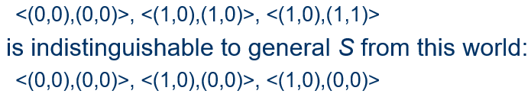
The Coordinated Attack Problem (Indistinguishable Worlds)
Defining the accessibility relation R_{i}:
Example World:
Two histories are indistinguishable to agent i if their final global states have identical local states for agent i
In words: S sends a message to R, but does not get an acknowledgement. This could be because R never received the message, or because he did but his acknowledgement did not make reach S

Slide 39
The Coordinated Attack Problem (What do generals know?)
Suppose the actual world is:
In this world, the following hold:
Unfortunately, this also holds:
R does not known that S knows that R knows that S intends to attack. Why? Because, from R’s perspective, the message could have been lost
<(0,0),(0,0)>, <(1,0),(1,0)>, <(1,1),(1,1)>
K_{s}attack
K_{R}attack
K_{S}K_{R}attack
¬K_{R}K_{S}K_{R}attack

Slide 40
The Coordinated Attack Problem (What do generals know?)
Possible solution:
Then we have:
Unfortunately, we also have:
Is there a way out of this?
S acknowledges R’s acknowledgement
K_{R}K_{S}K_{R}attack
¬K_{S}K_{R}K_{S}K_{R}attack

Slide 41
The “Everyone Knows” Operator
E_{G}ϕ denotes that everyone in group G knows ϕ
Semantics of “everyone knows”:
Let:
M,w |= E_{G}ϕ if and only if ∀i ∈G we have M,w |= K_{i}ϕ
M be a Kripke structure
w be a possible world in M
G be a group of agents
ϕ be a sentence of modal logic

Slide 42
The “Common Knowledge” Operator
When we say something is common knowledge, we mean that any fool knows it!
If any fool knows ϕ, we can assume that everyone knows it, and everyone knows that everyone knows that everyone knows it, and so on (infinitely).

Slide 43
The “Common Knowledge” Operator (formal definition)
C_{G}ϕ denotes that ϕ is common knowledge among G
Semantics of “common knowledge”:
Let:
M,w |= C_{G}ϕ if and only if M,w |= E_{G}(ϕ ∧ C_{i}ϕ)
Notice the recursion in the definition.
M be a Kripke structure
w be a possible world in M
G be a group of agents
ϕ be a sentence of modal logic

Slide 44
The “Common Knowledge” Operator (Axiomatization)
All we need is S5 plus the following:
Axiom (A3) E_{G}ϕ ↔ (K₁ϕ ∧ … ∧ K_{n}ϕ)
Axiom (A4) C_{G}ϕ → E_{G}(ϕ ∧ C_{i}ϕ)
Rule (R3) From ϕ → E_{G}(ψ ∧ ϕ) infer ϕ → C_{G}ψ
given G={1,…,n}
This is called the induction rule.

Slide 45
Back to Coordinated Attack
Whenever any communication protocol guarantees a coordinated attack in a particular history, in that history we must have common knowledge between the two generals that an attack is about to happen.
No finite exchange of acknowledgements will ever lead to such common knowledge.
There is no communication protocol that solves the Coordinated Attack problem.

Slide 46
5. Logics of knowledge and belief
Used to model "modes of truth" of cognitive agents
Distributed modalities
Cognitive agents ➔ characterise an intelligent agent using symbolic representations and mentalistic notions:
knowledge - John knows humans are mortal
beliefs - John took his umbrella because he believed it was going to rain
desires, goals - John wants to possess a PhD
intentions - John intends to work hard in order to have a PhD
commitments - John will not stop working until getting his PhD

Slide 47
Logics of knowledge and belief
How to represent knowledge and beliefs of agents?
FOPL augmented with two modal operators K and B
Associate with each agent a set of possible worlds
Kripke model M_{a} of agent a for a formula ϕ
M_{a} =<W, R, I> with R ⊆ A x W X W
And I - interpretation of the formula on a Kripke frame <W,R> which makes the formula true for agent a

Slide 48
Logics of knowledge and belief
An agent knows a propositions in a given world if the proposition holds in all worlds accessible to the agent from the given world
An agent believes a propositions in a given world if the proposition holds in all worlds accessible to the agent from the given world
The difference between B and K is given by their properties
M_{a} |=_{W} Kϕ iff ∀w': R(w,w') ⇒ M_{a} |=_{W'} ϕ
M_{a} |=_{W} Bϕ iff ∀w': R(w,w') ⇒ M_{a} |=_{W'} ϕ

Slide 49
Properties of knowledge
(A1) Distribution axiom:
(A2) Knowledge axiom:
"The agent ought to be able to reason with its knowledge"
(ϕ →ψ) → (ϕ → ψ) (Axiom of distribution of modality)
K(a,ϕ →ψ) → ( K(a,ϕ) → K(a,ψ) )
"The agent can not know something that is false"
□ ϕ → ϕ (T) - satisfied if R is reflexive
K(a, ϕ) → ϕ

Slide 50
Properties of knowledge
(A3) Positive introspection axiom
(A4) Negative introspection axiom:
□X → □□X (S4) - satisfied if R is transitive
K(a, ϕ) → K(a, K(a, ϕ))
◊X → □◊ X (S5) - satisfied if R is euclidian

Slide 51
Inference rules for knowledge
(R1) Epistemic necessitation
(R2) Logical omniscience
|- ϕ ⇒ K(a, ϕ)
modal rule of necessity |- ϕ ⇒ ϕ
ϕ → ψ and K(a, ϕ) ⇒ K(a, ψ)

Slide 52



Properties of belief
Distribution axiom: B(a, ϕ) ∧ B(a, ϕ → ψ) → B(a, ψ)
Knowledge axiom: B(a, ϕ) → ϕ
Positive introspection axiom: B(a, ϕ) → B(a, B(a, ϕ))
Negative introspection axiom: ¬B(a, ϕ) → B(a, ¬B(a, ϕ))

Slide 53
Inference rules for belief
(R1) Epistemic necessitation
(R2) Logical omniscience
|- ϕ ⇒ B(a, ϕ) problematic
modal rule of necessity |- ϕ ⇒ ϕ
ϕ → ψ and B(a, ϕ) ⇒ B(a, ψ) usually NO

Slide 54
Some more axioms for beliefs
Knowing what you believe:
Believing what you know:
Have confidence in the belief of another agent:
B(a, ϕ) ⇒ K(a, B(a, ϕ))
K(a, ϕ) ⇒ B(a, ϕ)
B(a₁, B(a₂,ϕ)) ⇒ B(a₁, ϕ)

Slide 55
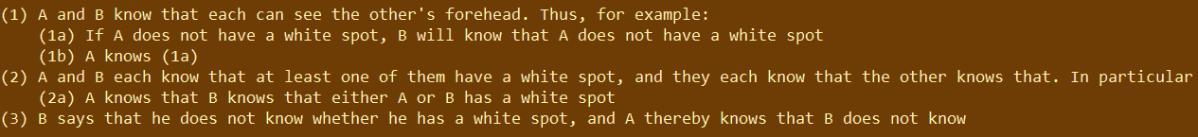
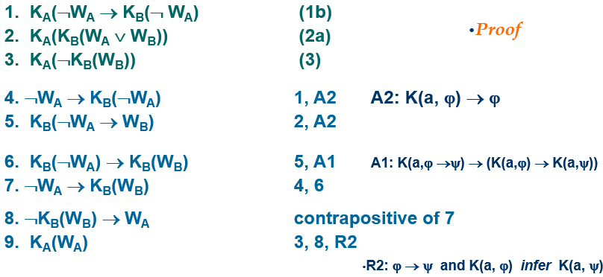
Two-wise men problem - Genesereth, Nilsson

Slide 56
Reading
Logics for Knowledge and Belief. Chapter 13 of Multiagent Systems: Algorithmic, Game-Theoretic, and Logical Foundations. Y. Shoham, K. Leyton-Brown. Cambridge University Press, 2009.

